Slide 1
Cloud-Based Healthcare Appointment Management System
Team [Team Name] — Anindya Roy, [Member B], [Member C], [Member D]

Slide 2
Project Completion Status
Functional requirements delivered
Patients register, log in, and book / reschedule / cancel appointments
Providers set availability and view their daily schedule; admins manage clinics and users
Non-functional requirements delivered
Data secured in transit (HTTPS/TLS) and at rest (TDE on Azure SQL); hosted on Azure App Service with health monitoring
Lab phases completed
Phase 1 (compute/web), Phase 2 (database), Phase 3 (networking & security) complete; Phase 4 (auto-scaling / IaC) partially complete
Complete vs. not complete
Complete: web app, Azure SQL DB, VNet + NSGs, Entra ID login, Key Vault secrets
Not complete: full Terraform IaC and SMS appointment reminders (stretch goals)

Slide 3
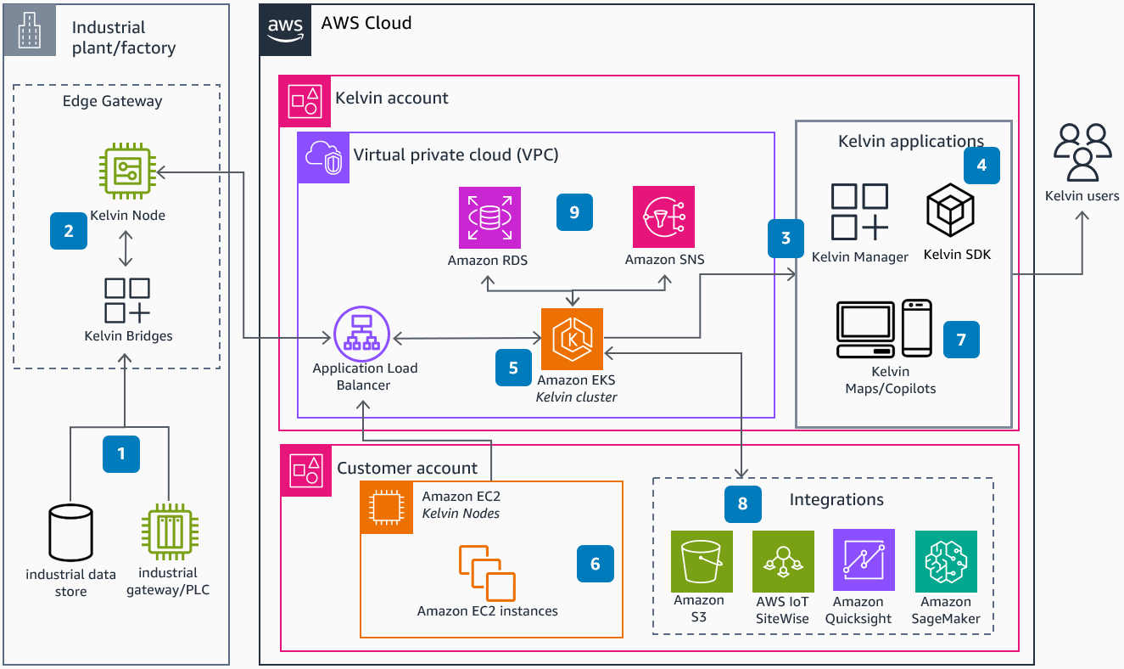
Project Solution Architectural Drawing
Internet (HTTPS/443) → Azure App Service (web tier) → private Azure SQL Database, all inside a VNet protected by NSGs, with Microsoft Entra ID for sign-in and Key Vault for secrets.
Paste your architecture diagram here (draw it yourself in draw.io). Show subnets, IP address ranges, and open ports — see the accompanying diagram guide. Delete this box once the diagram is in place.

Slide 4
Final Project Budget Projection
Estimated monthly cost (single region, low traffic, DB auto-pause on)
App Service Plan (Linux, Basic B1, 1 instance): ~$13 / mo
Azure SQL Database (General Purpose, serverless, 1 vCore, auto-pause): ~$47 / mo
Blob Storage (5 GB hot, LRS + transactions): ~$1 / mo
Networking (standard public IP + ~10 GB egress): ~$3.50 / mo
Key Vault (secret operations): ~$1 / mo
Entra External ID auth (under 50k MAU) and Application Insights (5 GB free): $0
Estimated total: ~$66 / month (~$790 / year)
Figures from the Azure Pricing Calculator; serverless DB cost scales with active hours, so real cost is often lower

Slide 5
Demonstration of Running System
Show the running website (3-5 minute live demonstration)
Load the website
Walk through the Azure Portal to show:
Web app on Azure App Service (Linux) with REST API endpoints
Azure SQL Database with appointment and patient tables
VNet, subnets, NSG rules, private endpoint, and IP address ranges
Auto-scale rule, deployment slot, and any extra Azure services
Security features:
Microsoft Entra ID sign-in (OAuth2 / OIDC) with role-based access
Encryption: TLS in transit and TDE at rest
NSG firewall rules; secrets stored in Azure Key Vault

Slide 6
Individual Contributions: Anindya Roy
Web application and Azure App Service deployment
Built the patient and provider UI: booking, rescheduling, and schedule dashboards
Configured Azure App Service (Linux), the CI/CD release pipeline, custom domain, and TLS
Connected the front end to the REST API and data layer

Slide 7
Individual Contributions: [Member B]
Database and data layer
Designed the schema (patients, providers, appointments, time slots) in Azure SQL Database
Wrote stored procedures and queries; enabled TDE and automated backups
Configured the private endpoint so the database is not publicly reachable

Slide 8
Individual Contributions: [Member C]
Networking and security
Designed the VNet, subnets, and NSG rules (ports 443 and 1433)
Set up Azure Key Vault with managed identity for connection strings and secrets
Configured firewall / border rules and enforced HTTPS

Slide 9
Individual Contributions: [Member D]
Authentication, monitoring, and operations
Integrated Microsoft Entra ID (OAuth2 / OIDC) with role-based access control
Set up Application Insights and Log Analytics dashboards and alerts
Configured auto-scale rules and partial Terraform infrastructure-as-code

Slide 10
Final Project Summary
Built a secure, Azure-hosted appointment system: App Service web tier, Azure SQL, private VNet, and Entra ID auth
Went well: Managed PaaS (App Service + Azure SQL) let us focus on the app; auth and TLS were quick to wire up
Tradeoffs: Serverless SQL (cheaper, small cold-start latency) over always-on; PaaS over self-managed VMs (less control, faster delivery)
Issues overcome: Private-endpoint DNS between App Service and Azure SQL; NSG rules initially blocked traffic on port 1433
Next time: Full Terraform IaC from day one, plus SMS / email reminders and load testing

Slide 11
Questions Time
Professor Crandall now asks questions of each member

